Slide 1
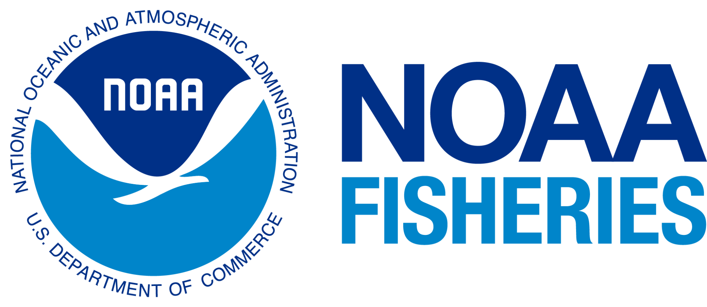
Evaluating the Coastal Environmental Impacts from the COVID-19 Shutdown
Mentor: Dr. Andrea Gomez
Communications Specialist
NOAA Fisheries
Summer Bridge Research Program 2022

Slide 2
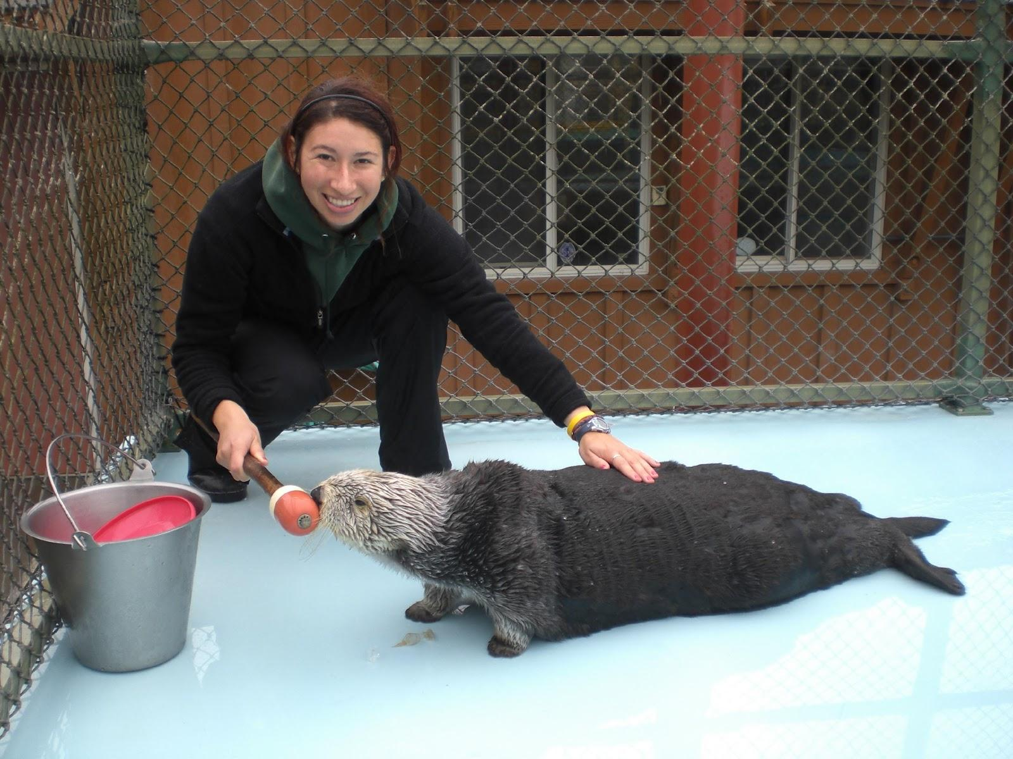
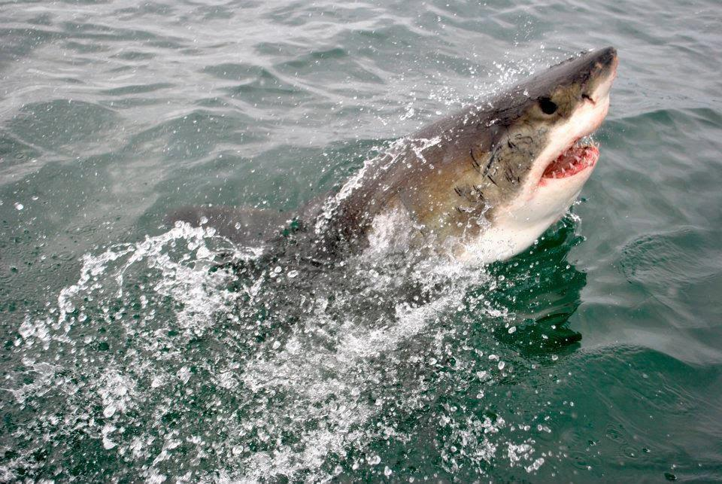
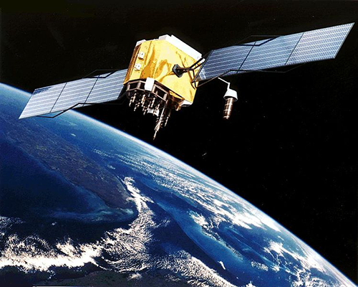
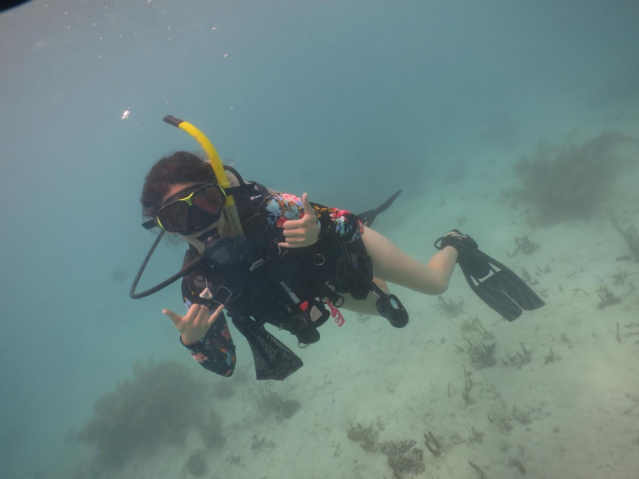
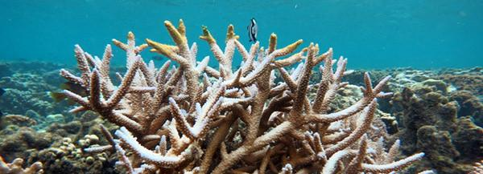
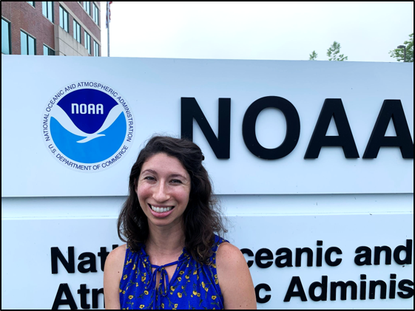
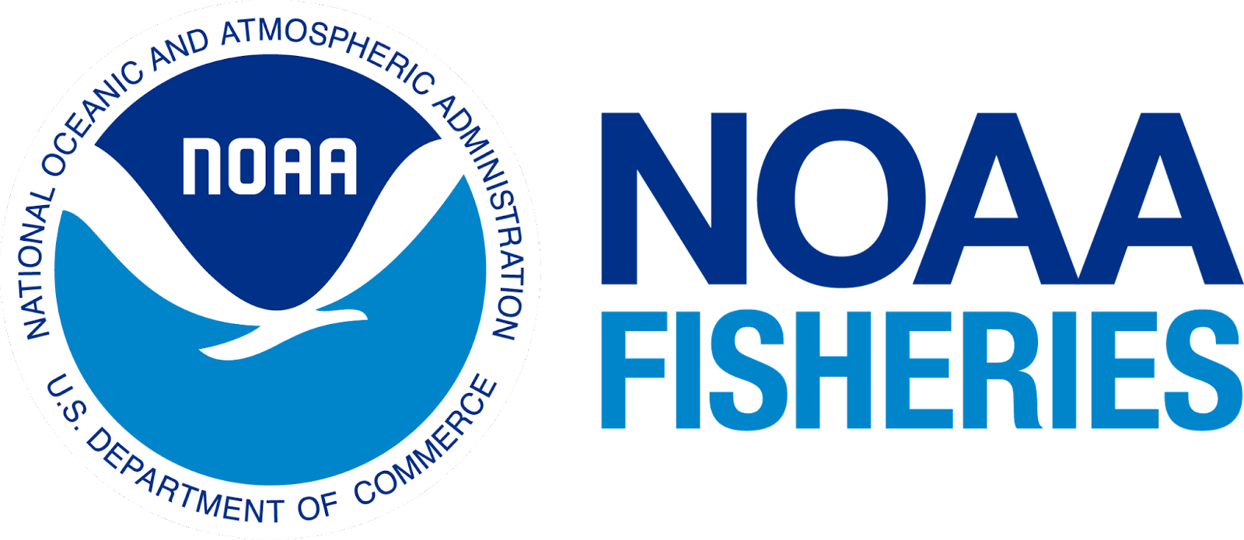
Andrea Gomez, Ph.D.
Hometown = Folsom, CA
Undergrad = University of California, Santa Cruz
Marine Biology
Master’s = City College of New York
Biology
NOAA CREST Fellow
Doctorate = The Graduate Center, CUNY
Earth and Environmental Sciences
NOAA CESSRST Fellow
Career:
NYU = Adjunct Faculty
NOAA Fisheries - Greater Atlantic Regional Fisheries Office

Slide 3
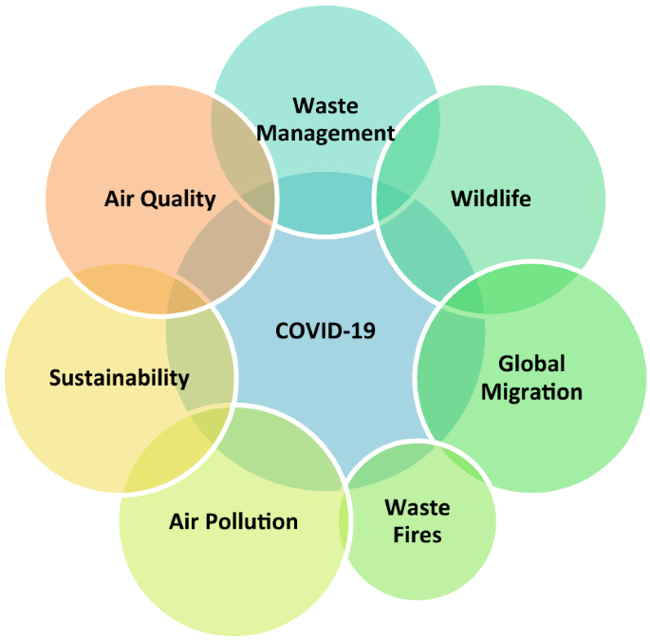
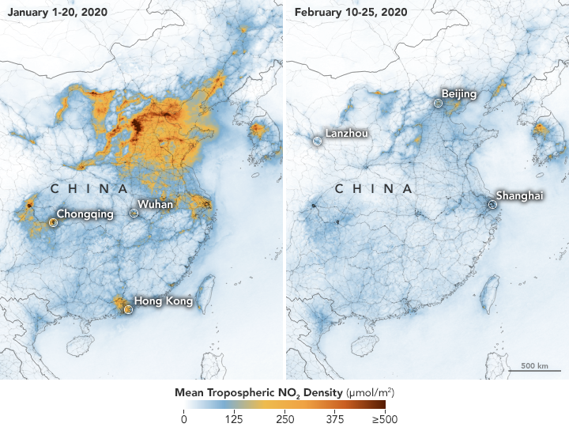
Research Question
How has the COVID-19 shutdown impacted the coastal environment?
Rupani et al. 2020
Josh Stevens/NASA Earth Observatory
Notes:
The COVID-19 pandemic was declared by the World Health Organization on 11 March 2020. With millions of people social distancing, and quarantining at home, this has given the oceans a much needed break from human interference. Remote sensing is a tool that can be used to help investigate how the COVID-19 shutdown affected the ocean and coastal environments.
Decrease carbon dioxide and greenhouse gases, Nasa maps showing NO2 values over Wuhan during January and February. Photograph: Nasa Handout/EPA. NO2 is mainly produced by vehicles, industrial sites and thermal power stations

Slide 4
Research Project
Satellite Remote Sensing:
Location?
Which type of data?
Air pollution (nitrogen oxide)
Sea surface temperature
Timeframe: 2012 - 2022
Social Media:
Science Communication
FaceBook and Twitter

Slide 5
Skills
Analyze datasets
Visualization and mapping of data (QGIS, NASA Giovanni)
Presentations
Science Communication (Hootsuite/Canva)

Slide 6
Thank you!

